Slide 1
S/4HANA Public Cloud
Upgrades Webinar
2608
Tara Critchley, Will Banks & Jeff Coote

Slide 2



Introductions
Jeff Coote
Will Banks
Tara Critchley
SAP Basis
AMS Lead
SAP Technical Consultant
SAP Service
Delivery Manager
Notes:
Tara

Slide 3

Poll
What are the most common challenges you have faced in a previous release/upgrade?

Slide 4

SAP Public Cloud Upgrades:
How to navigate the SAP 2608 Public Cloud release
How the updates may impact your current system landscape
Key areas AMS customers should be aware of
How to approach testing, validation, and adoption
Practical steps to prepare ahead of the release
4
we commit. we deliver.
Notes:
Tara

Slide 5

Agenda
  Upgrade releases
  What happens when?
1
  Pre-upgrade
2
  Mid-upgrade
3
  Post-upgrade
3
Notes:
Will
Share some technical info including dates and downtime
then
Take on a journey of the upgrade, and provide some detail on you as a customer need to do at each stage, and how we can help
Jeff will speak about the upgrade release information

Slide 6



Continuous Delivery
Release Upgrades
Hotfixes
Enhanced Hotfix
Major release, upgrades the system to version YYMM/xx
Scheduled twice a year (Feb/Aug)
Hotfix collection delivery
containing corrections
Corrections and/or additional functionality is shipped without side effects to already released software
Scheduled monthly as of 2608, deployed into Test
Hotfix collection delivery enhanced with critical fixes
Delivered 1 week after the initial hotfix
Deployed into Dev, Test and Prod
Notes:
Jeff
As part of public cloud SAP has committed to Continuous delivery of new features to you, as part of that commitment there are regular features delivered between the major release upgrades.
Hotfix / Continuous feature delivery schedule.
Note the monthly delivery schedule is changing as of the 2608 release.

Slide 7
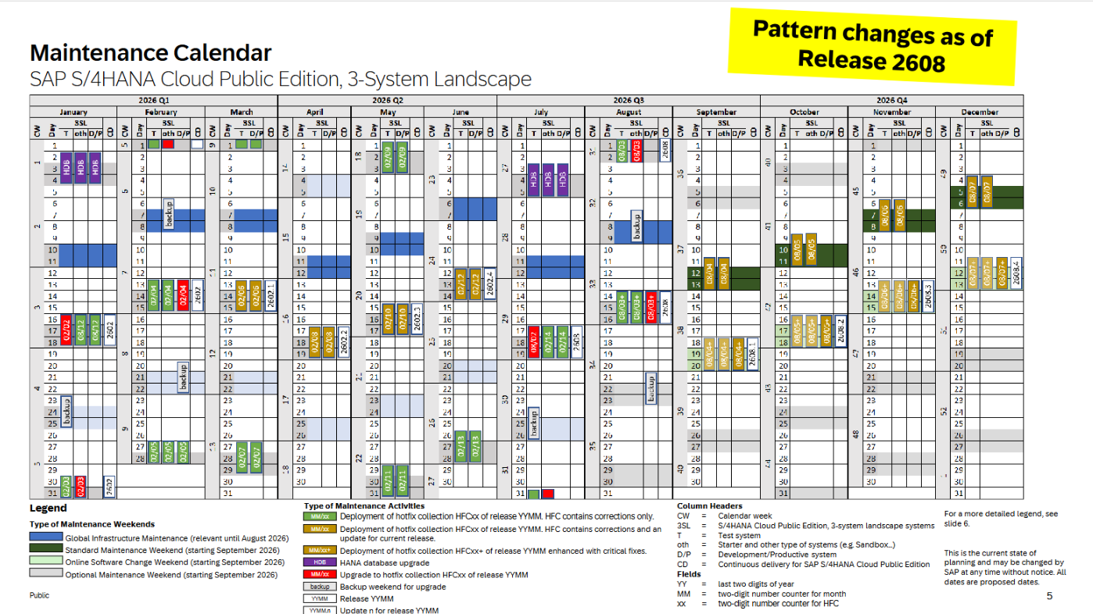
2026 Release Schedule
Pattern Changes as of Release 2608
SAP Maintenance presentation link
Notes:
Jeff
Note the change in scheduling as of 2608.
Hotfix collection delivery to Test for a one-week review window before a deployment to Dev/Prod (which will also contain any urgent critical fixes found in the original test deployment).
Mention the new monthly “standard maintenance weekend” for any urgent planned downtime – managed by SAP – keep an eye for SAP notifications.
Twice yearly HANA DB upgrade/s scheduled by SAP – typically in Jan/July.

Slide 8

What happens and when?
2602
Jan
Feb
Mar
Apr
May
Jun
Jul
Aug
Sep
Oct
Nov
Dec
2608
Releases include the year and month (YYMM) in the name e.g. 2602
8
we commit. we deliver.
Notes:
Jeff
Twice a year S/4HANA public cloud is updated to the latest release
A new release replaces the current system with a higher version, including latest innovations from the application and technology stack
Software and content are upgraded separately
The underlying SAP software is upgraded first in the following sequence:
Test system
Starter system (if not retired) one week later
Development and Production systems together at the end of the four-week upgrade period
Reference content is then upgraded in SAP CBC for activated Scope Items and must be transported through the landscape following the Prod upgrade.
Upgrades are mandatory and take place on regular pre-defined dates in August and February - Releases include the year and month (YYMM) in the name e.g. 2502

Slide 9
What happens and when?
2602
Jan/Feb
Mar
Apr
May
Jun
Jul/Aug
Sep
Oct
Nov
Dec
2608
Releases include the year and month (YYMM) in the name e.g. 2602
9
we commit. we deliver.
Notes:
Note the twice yearly – 6-week phases to support and manage the major release upgrade/s.
Critically there is a 4-week gap between the TEST & DEV/PROD upgrade/s – all regression testing to be done in that period.

Slide 10
System Landscape - Upgrade dates
3SL
Development
Test
Production
Jul. 18/19
Aug. 01/02*
Aug. 15/16
Aug. 15/16
Test
Production
2SL
Aug. 01/02
Aug. 15/16
*3SL Test systems are upgraded twice, with a hotfix delivered halfway through the testing period.
2SL Test systems are upgraded once only, with the enhanced collection
Notes:
Jeff
Note that the 2SL only receive one iteration of the hotfix upgrade

Slide 11
What happens when? - 2608
Key Upgrade Dates
CBC Content
Upgrades are Mandatory
July 15th: Availability of finalized User Assistance content on SAP Help Portal
Preliminary What’s New is already available
Updated after production upgrade.
You cannot opt-out of the upgrade.
July 18th/19th: Test systems
Delivered in transports which must move through the landscape.
If appropriate change management is not employed, disruptions will occur.
Aug. 15/16th: Production + Development systems
If starter systems are still in use (you are still in the project) - Aug. 01/02
Releases include the year and month (YYMM) in the name e.g. 2502
Testing is essential!
Notes:
Jeff
Twice a year S/4HANA public cloud is updated to the latest release
A new release replaces the current system with a higher version, including latest innovations from the application and technology stack
Software and content are upgraded separately
The underlying SAP software is upgraded first in the following sequence:
Test system
Starter system (if not retired) one week later
Development and Production systems together at the end of the four-week upgrade period
Reference content is then upgraded in SAP CBC for activated Scope Items and must be transported through the landscape
Upgrades are mandatory and take place on regular pre-defined dates in August and February
Releases include the year and month (YYMM) in the name e.g. 2502

Slide 12
2SL
Upgrade schedule per release and system type:
 | 2702 (est.) | 2608
Availability of User Assistance content on SAP Help Portal | Jan. 14* | Jul. 15
Q (Quality), Other system types (e.g. Sandbox, Trial) | Jan. 30/31* | Aug. 01/02
P (Production) systems | Feb. 13/14* | Aug. 15/16
3SL
Upgrade schedule per release and system type:
 | 2702 (est.) | 2608
Availability of User Assistance content on SAP Help Portal | Jan. 13* | Jul. 15
T (Test) systems | Jan. 16/17* | Jul. 18/19
S (Starter) and other type | Jan. 30/31* | Aug. 01/02
D (Development) and P (Production) systems | Feb. 13/14* | Aug. 15/16
*Dates for the 2702 release are projections based on previous releases
Notes:
Jeff
Note the projected dates for 2702 also

Slide 13
Upgrade Roadmap
15th August
Starter (if not retired) Development and Production System Software Upgrade
18th July
Test system Software Upgrade
Email Notification
Email Notification of Next Upgrade
Pre-upgrade
Mid-Upgrade
Post-Upgrade
Urgent Transports from Development to Production
WK - 6
WK - 0
WK - 3
WK - 4
Upgrade
Preparation
Regression Test Preparation
Role Remediation
Post Upgrade Test in Test System
Customer Test in Test System
Transport roles changes
Deploy Business Content
Notes:
Jeff
Will to talk to these phases in more detail – however note the timeline/s.
“Upgrade preparation” includes key items like aligning your landscape / transport consistency etc.

Slide 14
Pre-Upgrade
Before any systems are upgraded
Notes:
Will

Slide 15


Pre-upgrade
Customer
Review What’s New information
    Roles
    Removal/replacement of apps
    New features/functionality introduced
Prepare for a change freeze during the period of the upgrade
    In-flight changes should be completed before upgrade starts otherwise there is a potential to impact upgrade regression testing
  Prepare a Regression test plan focussing on
    Role changes
    Customisations
    Interfaces
Review What’s New, specifically:
    Identify adjustments needing a configuration change
    Highlight Roles adjustments
Export Roles snapshot to enable review and comparison against upgraded roles
15
we commit. we deliver.
Notes:
Will

Slide 16
What help/tools are available?
SAP provide an Activate roadmap dedicated to the upgrade that provides structure and details.
Release Assessment & Scope Dependency (RASD) is a tool that enables you to monitor and track the changes and enhancements brought in by the new release.
The tool provides the same information as the What's New documentation, but tailored to your company
These resources are accessed with your
customer S-User
What’s New Viewer & RASD
Final What’s New is released on the 15th of July
Preliminary What’s New is released 4 weeks before the upgrade.
It is currently available: Preliminary What's New - SAP S/4HANA Cloud Public Edition 2608 | SAP Help Portal
RASD tool: https://release-assessment-v2.cfapps.eu10.hana.ondemand.com/cp.portal/site#Shell-home
    SAP S/4HANA Cloud, Public Edition, 3-System Landscape – Upgrade & Maintenance Schedule
    SAP S/4HANA Cloud Public Edition, 2-System Landscape & SAP Marketing Cloud – Upgrade & Maintenance Schedule
Notes:
Will

Slide 17
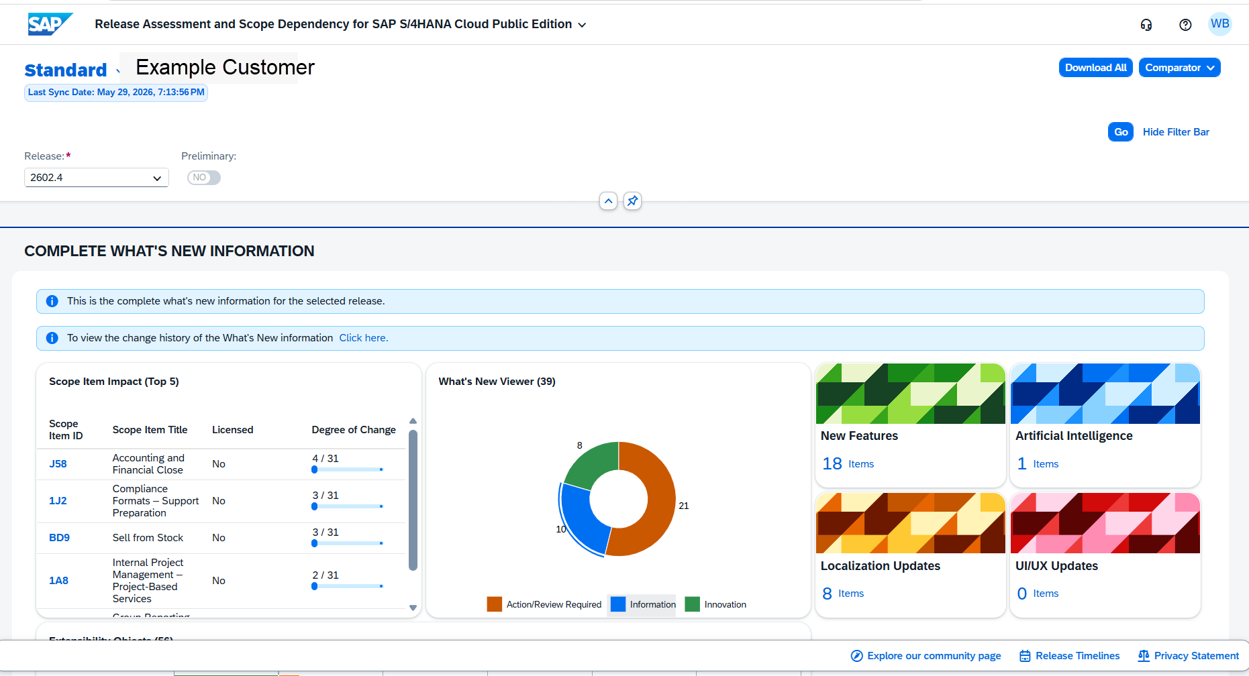
Release Assessment & Scope Dependency
Notes:
Will

Slide 18
Mid-Upgrade
After the test system is upgraded

Slide 19
IAM Changes - Roles
SAP Public Cloud authorization concept
The largest impact the upgrade will have is to the roles.
Each upgrade SAP delivers a large number of changes to the role design which must be adopted and tested.
These should be updated in time for the production upgrade.
Executed by support partner S&A team
Business Roles
Business Roles
Template
Business Catalog 1
Business Catalog 2
Restriction Type A
Restriction Type B
Restriction Type C
Restriction Type D
Restriction Type Field A1
Restriction Type Field A2
Restriction Type Field B
Restriction Type Field C1
Restriction Type Field D1
Notes:
Will

Slide 20
Role Change example
Basic example
1
2
3
Role consist of catalogs which grant access to apps
Due to the upgrade a catalog is deleted/deprecated
The catalog is removed by the upgrade, and the successor is not updated
4
5
The business users assigned that role will no longer have the access they need
Business processes are impacted
Proactive adjustments are required to prevent business interruption
Notes:
Will

Slide 21

Regression Testing
  4 weeks to: Identify issues so delaware (or your own AMS provider) and/or SAP can prepare a fix, adjust to and adopt new processes and features, ensure roles are tested and working correctly
  When the system is upgraded: The changes are immediately live on Monday, so it is important to ensure no business interruption.
  Automated testing: In the “Test Your Processes” app SAP provide pre-defined test plans to support your regression testing. Review to see if this can be used for your environments. Setup required.
Notes:
Will

Slide 22
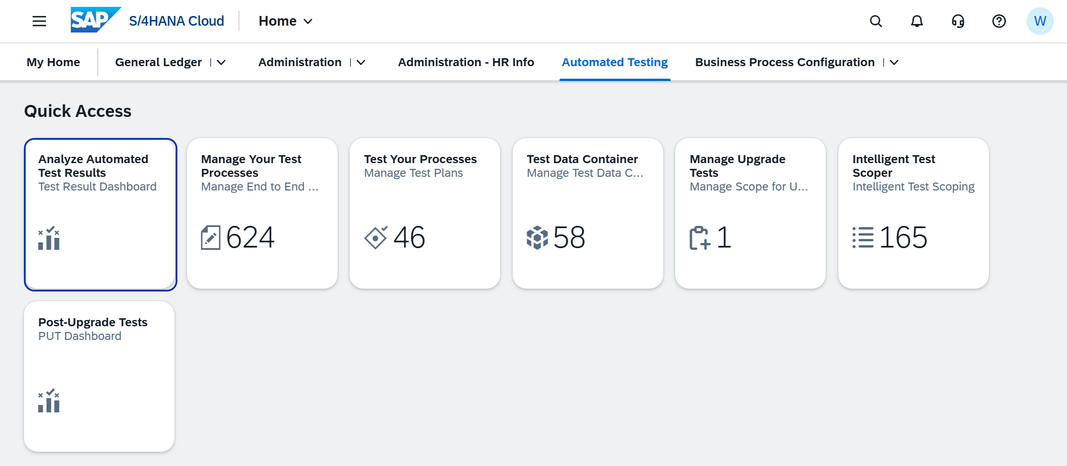
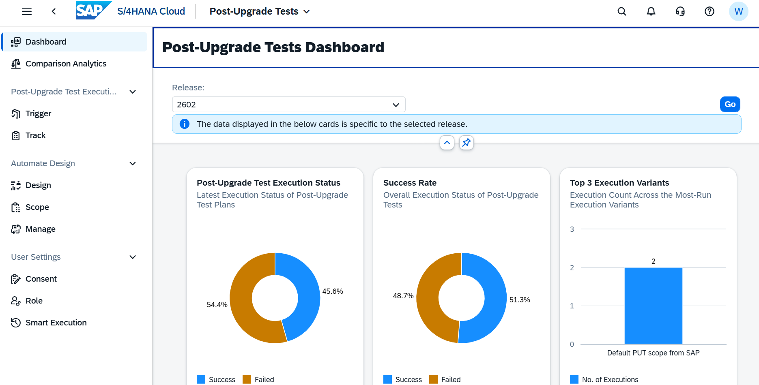
Automated Testing from SAP
Setup required
Notes:
Will

Slide 23
Restrictions during the upgrade*
Phase
Time (EMEA)
Restrictions
Test
Restrictions
Development &Production
Uptime | THU 18:00 UTC to SAT 00:00 UTC | No imports or forwarding of transports possible | CBC in maintenance mode – deployment is disabled No export/import of transports No data migration
Downtime** | SAT 19:00 UTC to SAT 23:00 UTC (PROD) SAT 11:00 UTC to SAT 15:00 UTC (DEV) | No logon to system | No logon to system
* Downtime windows shown are for the EMEA region. Other regions have different windows.
** If maintenance activities do not require the complete downtime window, systems are released earlier
Notes:
Will

Slide 24
Post-Upgrade
After the production system is upgraded

Slide 25


Post-Upgrade Actions
Customer
Raise tickets
Delaware team will review for regression issues and handle accordingly
Adopt new features and processes
Move CBC and Role transports through landscape
    Ensure the landscape is consistent by moving all CBC and roles transports into Production
Handle defects as they are raised
Confirm system is upgraded successfully
If the work has been done before this point, there will be very few issues!

Slide 26

Post Upgrade – Activating new features
Upgrades enable all features by default
The mid-cycle updates include optional pre-deliveries of new functionality
Functionalities delivered between upgrades can be switched by using the ”Activate Features” configuration activity
If a delivered functionality is not yet required, or the respective change management currently cannot be executed, it is not mandatory to switch it on
Future webinar on new features
29th July 2026
Notes:
Will
Finally? How do you use all these continuous improvements?
SAP switch on everything during a major upgrade. Anything delivered between you can choose to activate.

Slide 27
Q&A & Next Steps
Notes:
Tara to co-ordinate

Slide 28
thank you for your time

Slide 29
W/C | Monday | Tuesday | Wednesday | Thursday | Friday | Saturday | Sunday
6th July
13th July
20th July | box on Role adjustments
27th July
3rd August | Month end – consider impact on regression testing
10th August
17th August
Review Preliminary What's New
Complete in-flight changes before Q system upgrade
Prepare Test plan: Review Scope items in scope for testing and priority
Prepare Test plan: Review Scope items in scope for testing and priority
Review Roles/Access Management Changes
Q System Upgrade to 2608
(3SL)
Review Final What's New
Remind Business of change freeze
Open posting period in Q for testing
Roles Snapshot taken
Review Final What's New
IAM DB export from Q
Review Identity and Access Management Changes
Regression testing in Q system & remediation
Q System Upgrade to 2608
(2SL)
Adopt/Remediate Identity and Access Management Changes in Q-
Recommend regular stand up calls to review
Review Known Errors discovered in testing
Regression testing in Q system
Adopt/Remediate Identity and Access Management Changes in Q-
D/P System Upgrade to 2608
Regression testing in Q system
Adopt/Remediate Identity and Access Management Changes in Q
Adopt changes in P
Potential for additional support required as new changes affect entire business post go-live

Slide 30
W/C | Monday | Tuesday | Wednesday | Thursday | Friday | Saturday | Sunday
6th July
13th July
20th July | here box on Role adjustments
27th July
3rd August | Month end – consider impact on regression testing
10th August
17th August
Review Preliminary What's New
Complete in-flight changes before Q system upgrade
Prepare Test plan: Review Scope items in scope for testing and priority
PRE-UPGRADE
Prepare Test plan: Review Scope items in scope for testing and priority
Review Roles/Access Management Changes
Q System Upgrade to 2608
(3SL)
Review Final What's New
Remind Business of change freeze
Open posting period in Q for testing
Roles Snapshot taken
Review Final What's New
Recommend regular stand up calls to reviewReview Known Errors discovered in testing
IAM DB export from Q
Review Identity and Access Management Changes
MID-UPGRADE
Regression testing in Q system & remediation
Adopt/Remediate Identity and Access Management Changes in Q-
Regression testing in Q system
Adopt/Remediate Identity and Access Management Changes in Q-
D/P System Upgrade to 2608
Regression testing in Q system
Adopt/Remediate Identity and Access Management Changes in Q
Adopt changes in P
POST-UPGRADE
Potential for additional support required as new changes affect entire business post go-live

